Slide 1
Central Nervous system
Nerve cells and protection of the CNS

Slide 2
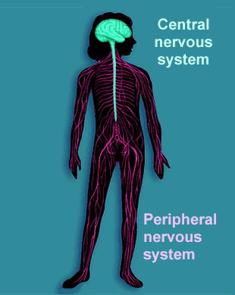

Slide 3
Protection of the CNS
The brain and spinal cord are protected by
  Bone
  Membranes called meninges
  Cerebrospinal fluid (CSF)

Slide 4
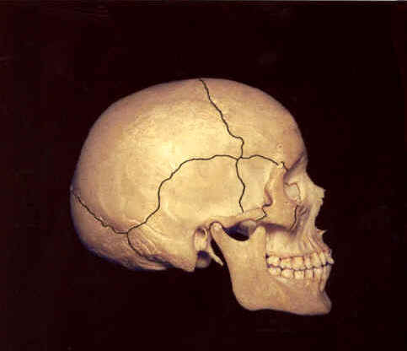
Bone
Cranium – protects the brain

Slide 5
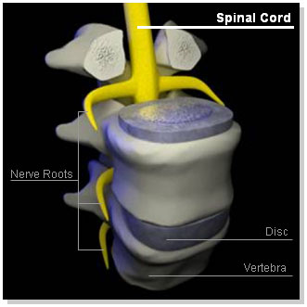
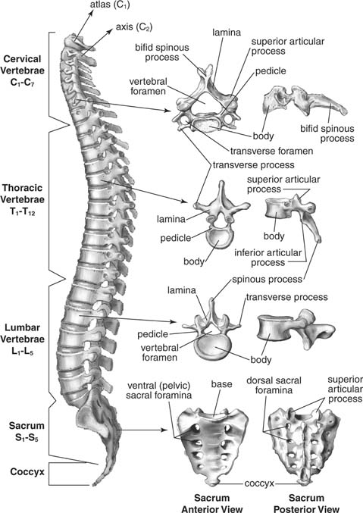
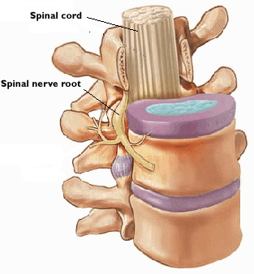
Bone
Vertebral canal – protects the spinal cord

Slide 6
Meninges
Cover the surface of the brain and the spinal cord.
Contains three layers.
Outside (dura mater): tough and fibrous
Middle (arachnoid mater): loose mesh of fibres
Inner (pia mater): blood vessels that stick close to the surface of the brain and spinal cord.

Slide 7
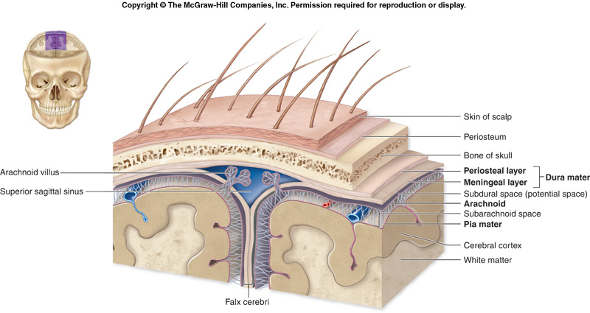
Meninges
Outer Middle Inner

Slide 8
Cerebrospinal fluid (CSF)
Found in between the middle and inner layers of the meninges.
It acts as a shock absorber cushioning any blows or shocks the CNS may experience
Formed from the blood and takes waste away and nutrients to the cells of the CNS.
Supports the brain – as the brain floats in CSF.

Slide 9
